Slide 1
Operating Systems: Introduction
Abhijit A. M.
abhijit.comp@coep.ac.in
(C) Abhijit A.M.
Available under Creative Commons Attribution-ShareAlike License V3.0+
Credits: Slides of “OS Book” ed10.

Slide 2
Initial lectures
We will solve a jigsaw puzzle
of how the computer system is built
with hardware, operating system and system programs

Slide 3
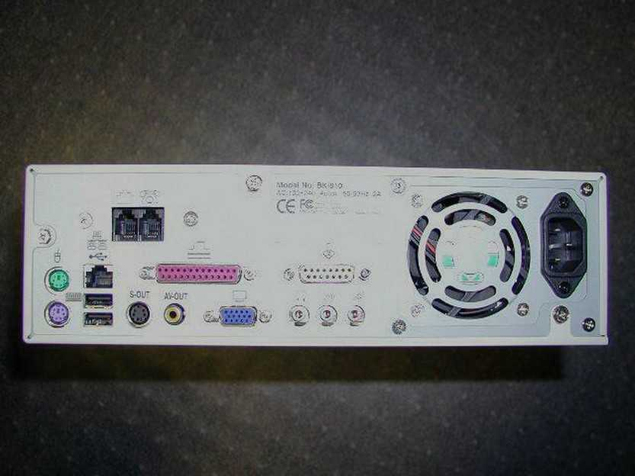
The “Ports”, what users see

Slide 4
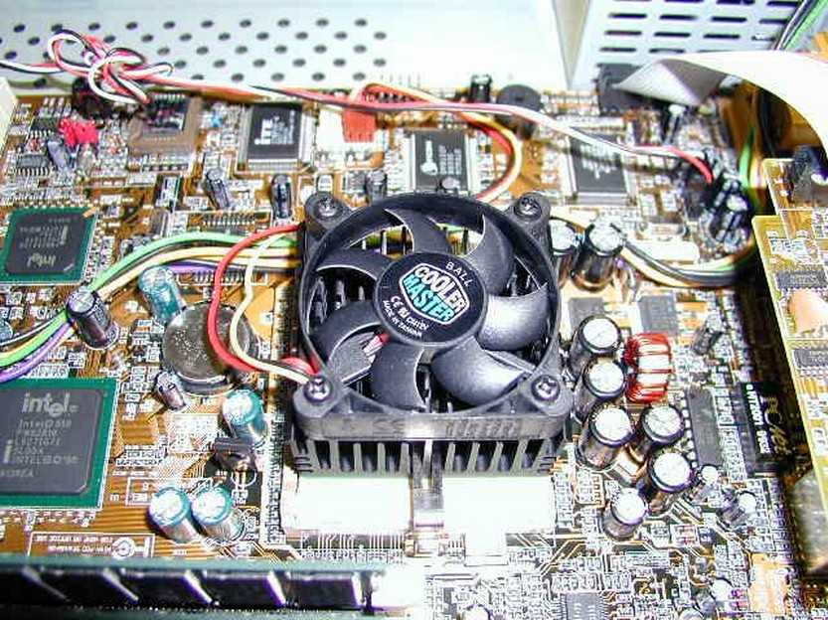
Revision: Hardware : The Motherboard

Slide 5
CPU/Processor
I3,i5, etc.
Speeds: Ghz
“Brain”
Runs “machine instructions”
The actual “computer”
Questions:
  Where are the instructions that the processor runs?

Slide 6
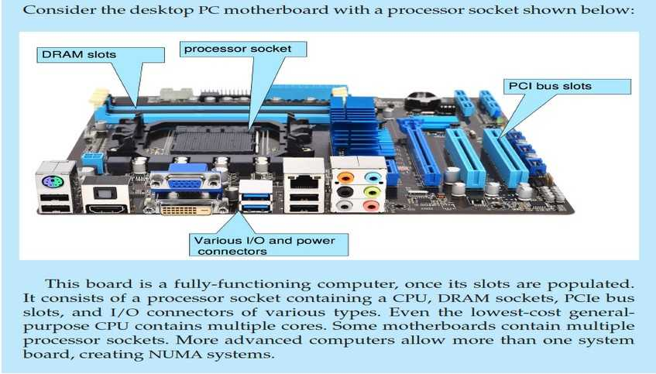
What’s on the motherboard?

Slide 7
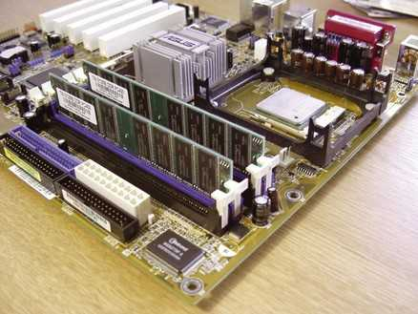
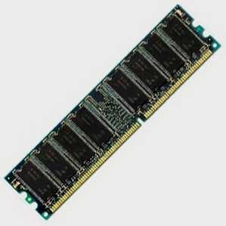
Memory
Random Access Memory (RAM)
  Same time of access to any location – randomly accessible
  Semiconductor device

Slide 8
Question:
Can we add more RAM to a computer?

Slide 9
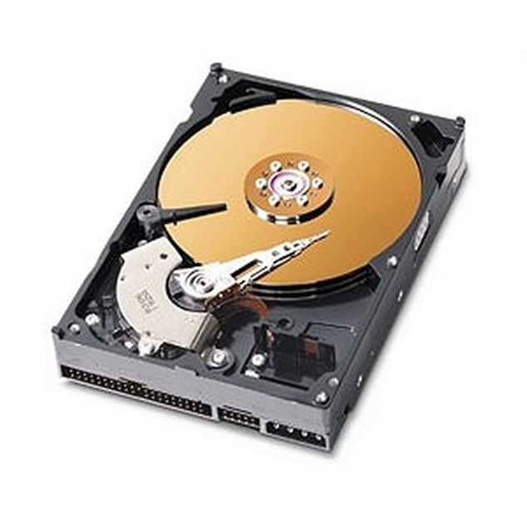
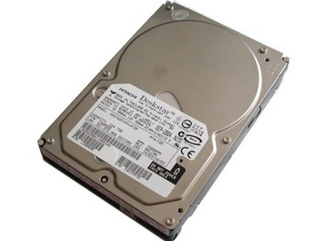
The Hard Drive

Slide 10
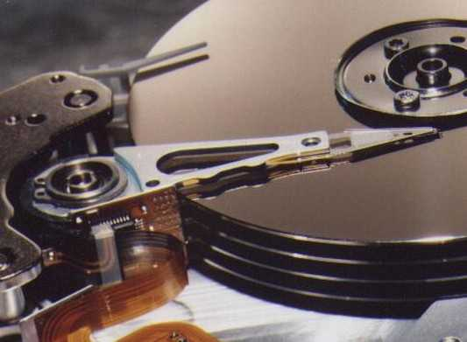
The Hard Drive
Spindle
Magnetic disks
Head

Slide 11
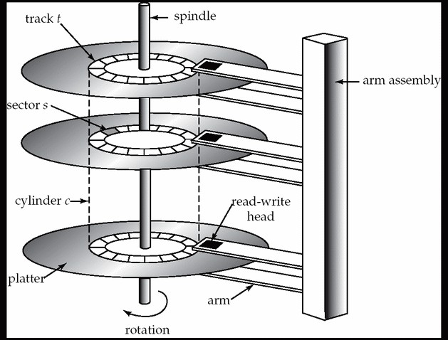
The hard Drive

Slide 12
The Hard Drive
Is a Magnetic device
Each disk divided into tiny magnetic spots, each representing 1 or 0
  What's the physics ?
  Two orientations of a magnet
Is “persistent”
  Data stays on powering-off
Is slow
IDE, SATA, SCSI, PATA, SAS, …

Slide 13
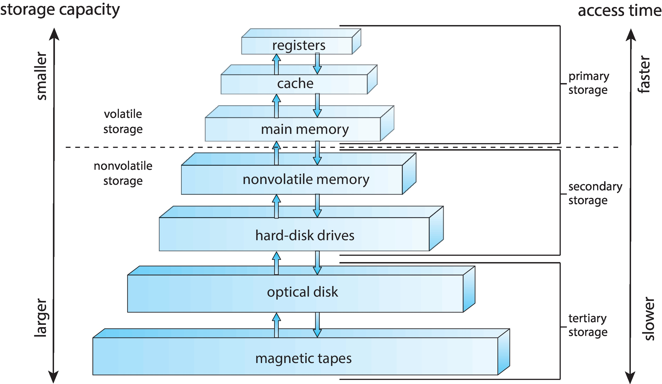
Storage-Device Hierarchy

Slide 14
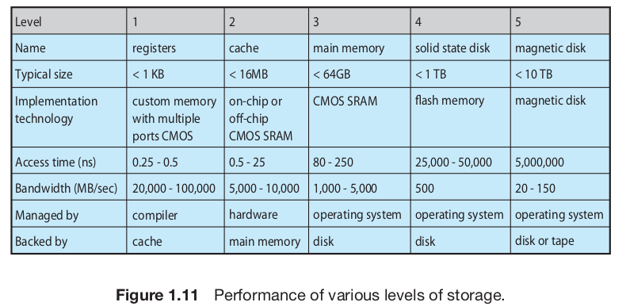

Slide 15
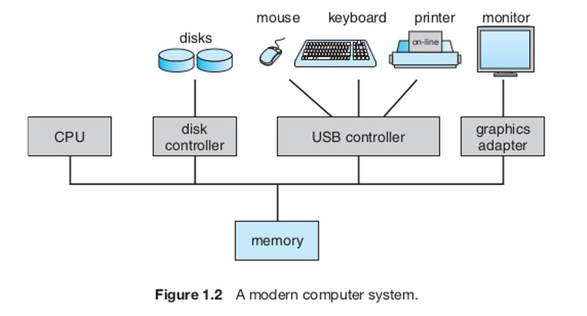
Computer Organization
https://aycaakcay.medium.com/computer-system-organization-6f04c5a314fd

Slide 16
Important Facts
Processor (CPU) transfers data between itself and main memory(RAM) only!
No data transfer between CPU and Hard Disk, CPU and Keyboard, CPU and Mouse, etc.
I/O devices transfer (how?) data to memory(RAM) and CPU instructions access data from the RAM

Slide 17
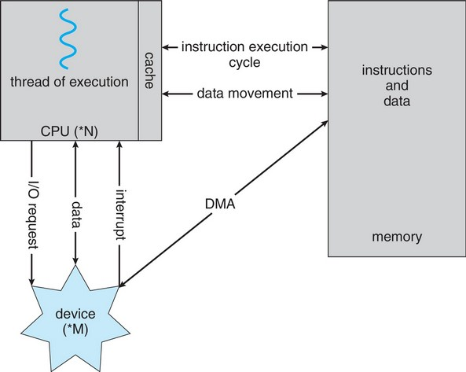
How a Modern Computer Works
A von Neumann architecture

Slide 18
What does the processor do?
From the moment it’s turned on until it’s turned off, the processor simply does this
  Fetch the instruction from RAM (Memory).
    Location is given by Program Counter (PC) register
  Decode the instruction and execute it
    While doing this may fetch some data from the RAM
  While executing the instruction change/update the Program Counter
  Go to 1

Slide 19
Immediate questions
What’s the initial value of PC when computer starts ?
Who puts “this” value in PC ?
What is there at the initial location given by PC ?

Slide 20
A critical question you need to keep thinking about ...
Throughtout this course, With every concept that you study, Keep asking this question
Which code is running on the processor?
  Who wrote it?
  Which code ran before it
  Which code can run after it
Basically try to understand the flow of instructions that execute on the processor

Slide 21
Few terms
BIOS
  The code “in-built” into your hardware by manufactuerer
  Runs “automatically” when you start computer
  Keeps looking for a “boot loader” to be loaded in RAM and to be executed
Boot Loader
  A program that exists on (typically sector-0 of) a secondary storage
  Loaded by BIOS in RAM and passed over control to
  E.g. “Grub”
  It’s job is to locate the code of an OS kernel, load it in RAM and pass control over to it

Slide 22
Kernel, System Programs, Applications
Kernel
  The code that is loaded and given control by BIOS initially when computer boots
  Takes control of hardware (how?)
  Creates an environment for “applications” to execute
  Controls access to hardware by applications,
  Etc.
Everything else is “applications”
  System programs: applications that depend heavily on the kernel and processor
  E.g. Compiler, linker, loader, etc.
  Other applicatiosn: GUI, Terminal, Libreoffice, Firefox, VLC, ... Your own programs from data structures, etc.

Slide 23
How is a modern day
Desktop system
built
on top of
this type of hardware?

Slide 24
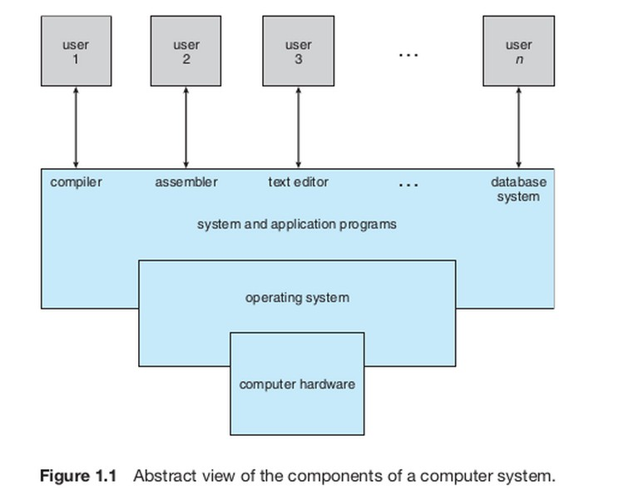
Components of a computer system

Slide 25
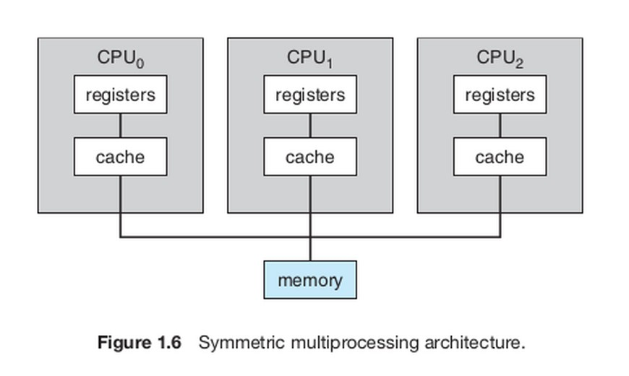
Multiprocessor system: SMP

Slide 26
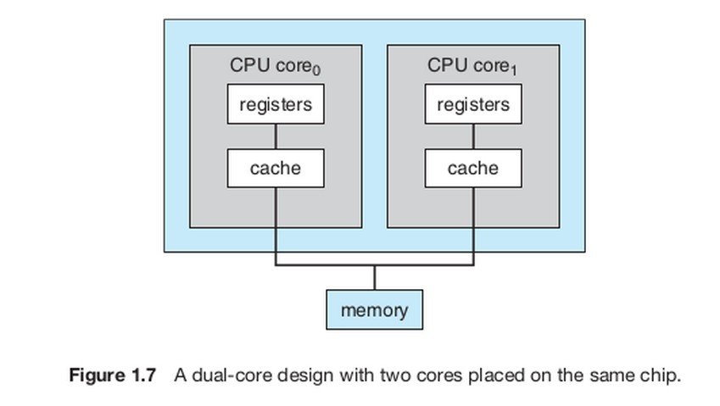
Dual Core: what’s that?

Slide 27
The very important question:
Who does what?
What is done in hardware, by OS, by compiler, by linker, by loader, by human end-user?
There is no magic!
A very intelligent division of work/labour between different components of the computer system makes a system

